Slide 1
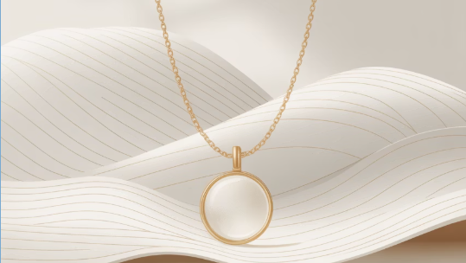
NYMPHORA
BY LEARNING TEAM- 2

Slide 2
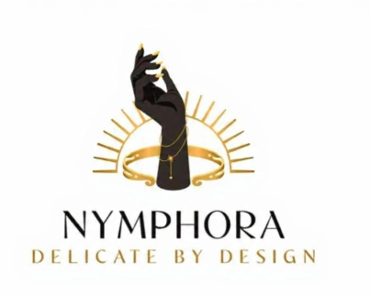
INTRO TO BRAND & PRODUCT
Brand: Nymphora
Industry: Fashion Accessories & Lifestyle
Product Category: Dainty / Minimalist Jewelry
What Nymphora Stands For: Nymphora is a digital-first jewelry brand offering delicate, minimalist pieces designed for everyday elegance and emotional expression.
Target Customer Focus: Nymphora targets urban Gen Z and young millennial consumers who prefer subtle, everyday jewelry over occasion-led pieces. We focus on young women who wear jewelry as part of their daily style, while also appealing to thoughtful male gifters seeking elegant, low-risk choices. The brand is positioned as a minimalist, emotionally relevant jewelry label designed for repeat wear and everyday confidence.

Slide 3
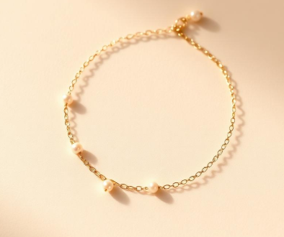
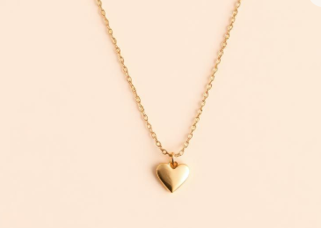
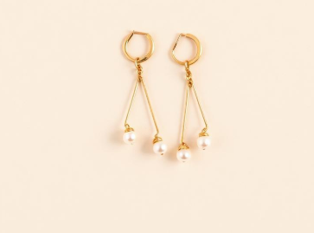
Product Categories
Necklaces
Delicate necklaces designed for effortless everyday elegance. From minimalist pendants to subtle chains, each piece is crafted to complement your daily style with quiet sophistication.
Earrings
Elegant earrings that elevate your everyday styling. From delicate studs to minimalist hoops, each pair is designed to bring effortless charm to any outfit.
Bracelets
Lightweight bracelets that add a refined touch to your everyday look. Designed for comfort and subtle beauty, these pieces layer beautifully or shine on their own.

Slide 4
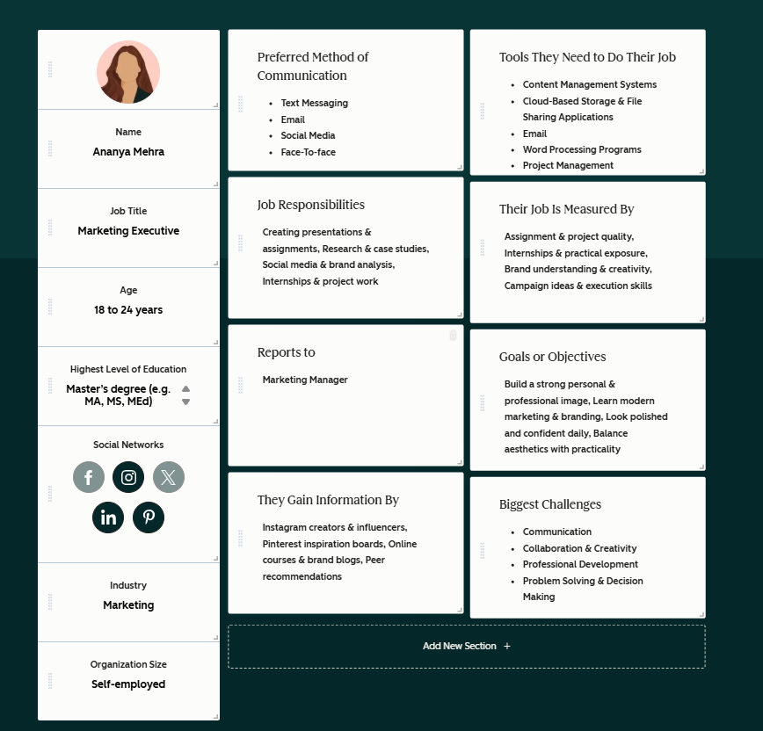
PERSONA 1

Slide 5
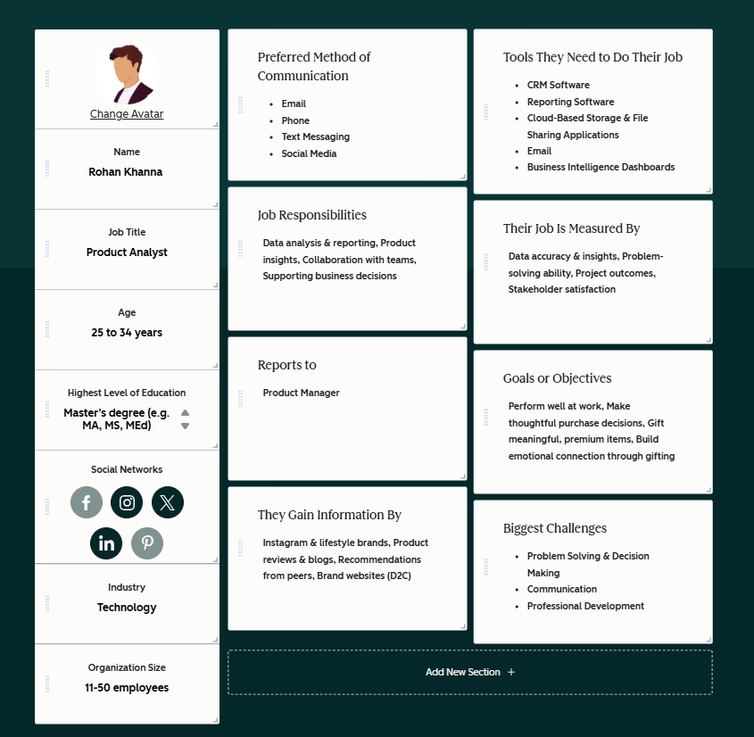
PERSONA 2

Slide 6
COMPETITOR ANALYSIS & DIGITAL INSIGHTS
What we examined
Digital product communication of GIVA and Salty, two leading players in the contemporary jewelry space.
What Apify helped validate
Using Apify, we analysed competitor category pages to understand how these brands present products, value, and usage digitally.
Key insight from analysis
Both brands emphasise product variety, quality assurance, and promotional cues, with limited focus on everyday lifestyle storytelling.
Gap identified
Everyday, repeat-wear jewelry is communicated functionally, not emotionally.
Nymphora’s opportunity
Nymphora positions itself as an everyday-first, minimalist jewelry brand that builds habit and emotional relevance beyond one-time purchases.

Slide 7
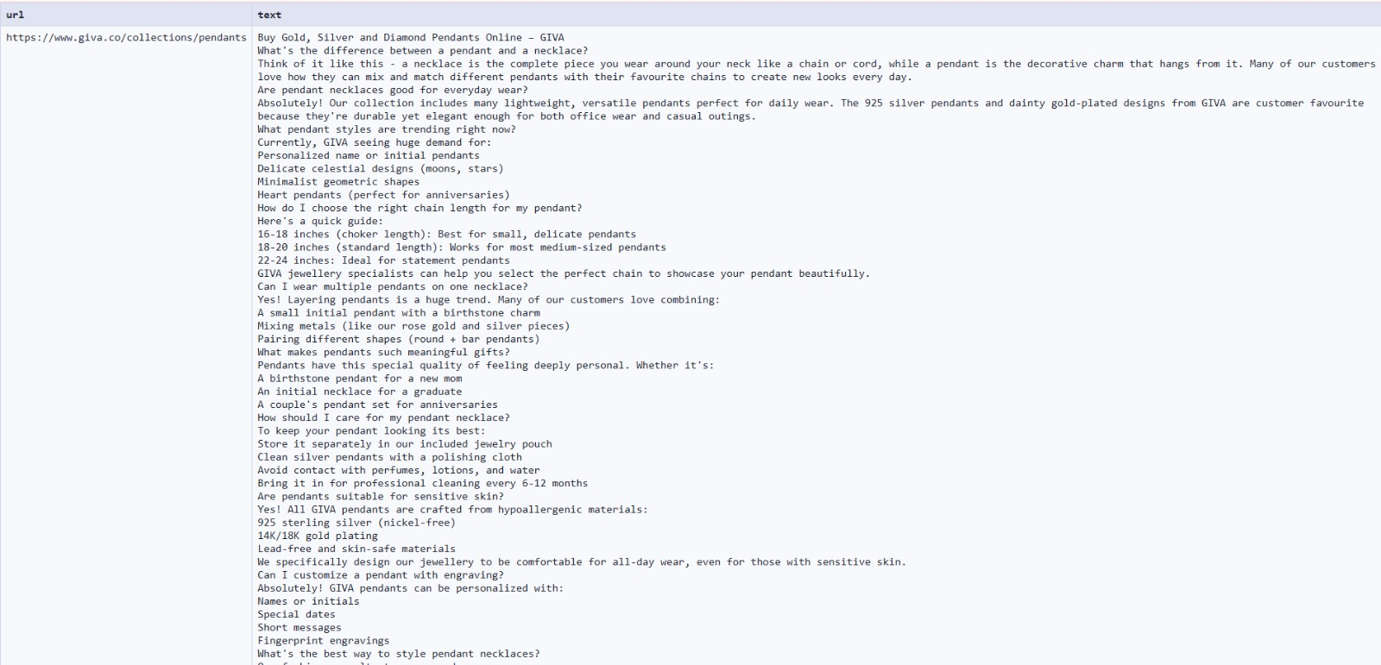
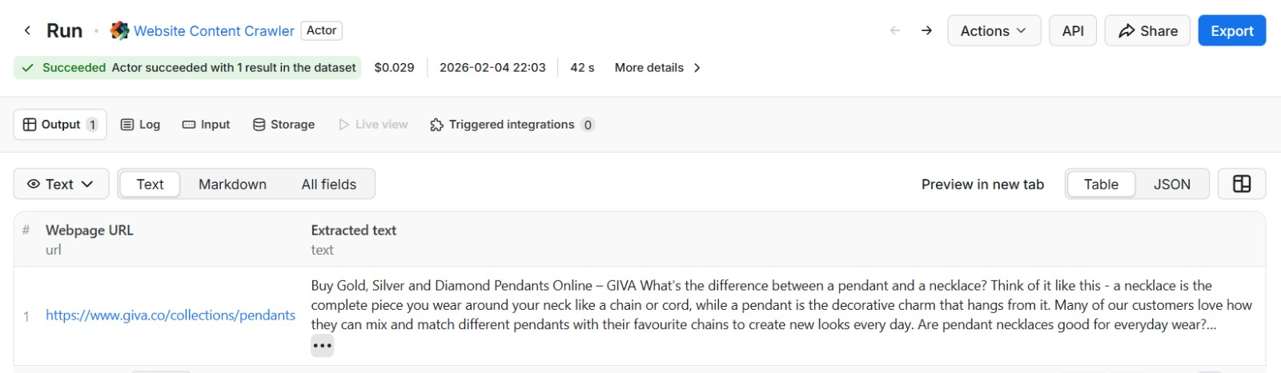
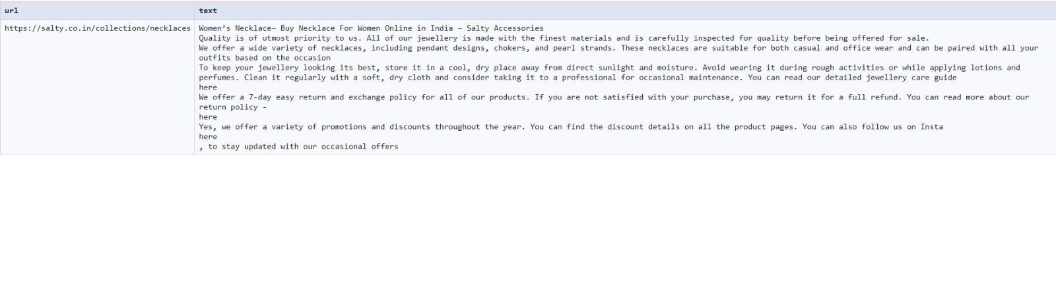
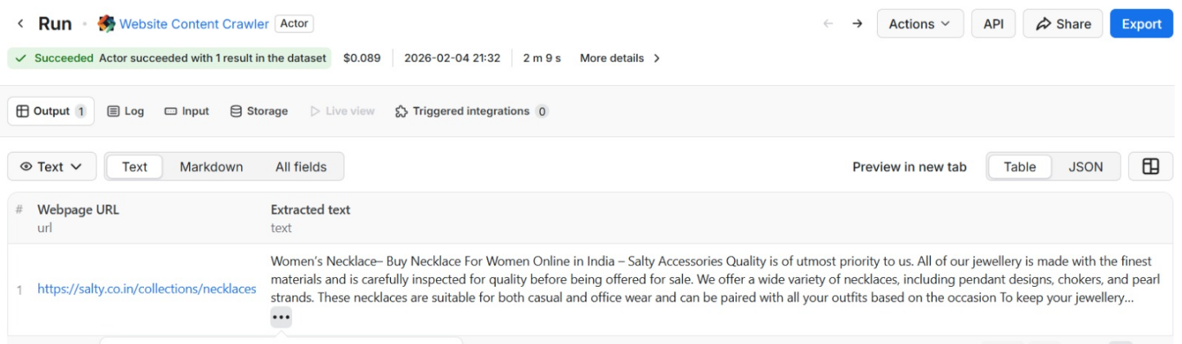
APIFY SCREENSHOT

Slide 8
THE MARKETING FUNNEL
Creating sense of urgency- having dainty jewelry in vanity is ESSENTIAL for 2026 fashion
MOFU- consideration
Objective: Help customers understand how Nymphora fits into daily style.
Browsable catalogs, lookbooks, & style guide that allow slow, intentional decision making
BOFU- conversion
Objective: Encourage customers to make their first purchase.
Subtle prompts around gifting & personal milestones to encourage purchase without urgency pressure
TOFU- awareness
Objective: Introduce Nymphora as an everyday minimalist jewelry brand.
Promoting everyday styling with dainty jewelry through subconscious attempt at creating GRWM type content
How minimalist jewelry elevates everyday basics
Aesthetic website with specific color patterns,, intuitive product positioning & enhanced display for seamless first-time shopping experience.

Slide 9
POEM Framework
Paid Media (Used to increase brand visibility and reach new audiences.)
Instagram ads
Influencer collaborations
Retargeting ads for website visitors
Owned Media (Platforms fully controlled by the brand for storytelling and product discovery.)
Nymphora website
Instagram page
Email newsletters
Earned Media (Organic visibility created through customer engagement and social sharing.)
Customer reviews
User-generated content
Influencer mentions and tags

Slide 10
Lead Magnet & Nurturing Strategy
Lead Magnet
Customer Nurturing Strategy
To encourage first interaction and email signup, Nymphora offers value-driven incentives that align with the brand’s everyday elegance positioning.
• Complimentary Jewelry Care Kit with first purchase to promote long-term product use
• Birthday Reward – special discount or small surprise gift during the customer’s birthday month
• Referral Benefit – customers receive a reward when they refer a friend who makes a purchase
• Early Access to New Collections for subscribers before public launch
To build long-term engagement and repeat purchases, Nymphora focuses on relationship-based communication.
• Email newsletters with styling inspiration and minimalist fashion tips
• Styling inspiration sections on the website showing how jewelry complements everyday outfits
• Personalised product recommendations based on browsing or purchase behaviour
• Exclusive collection previews and launch notifications

Slide 11
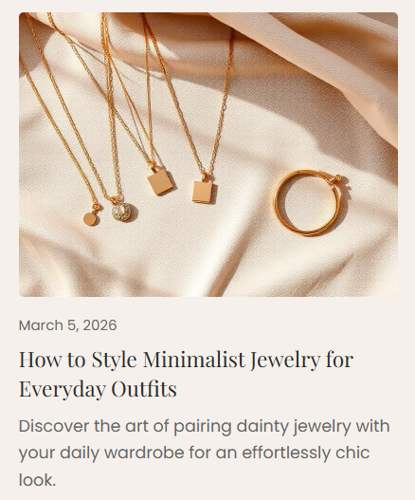
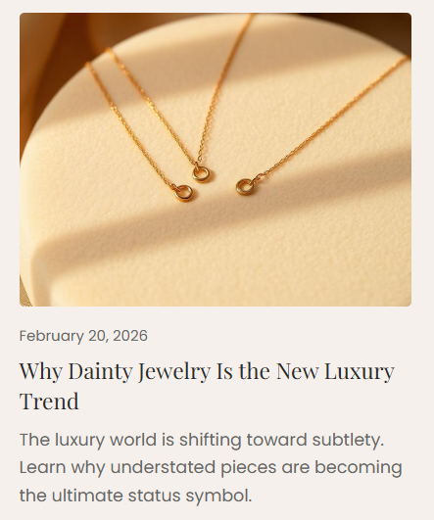
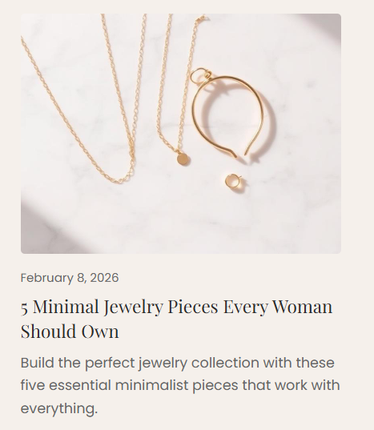
SEO Blog Strategy

Slide 12
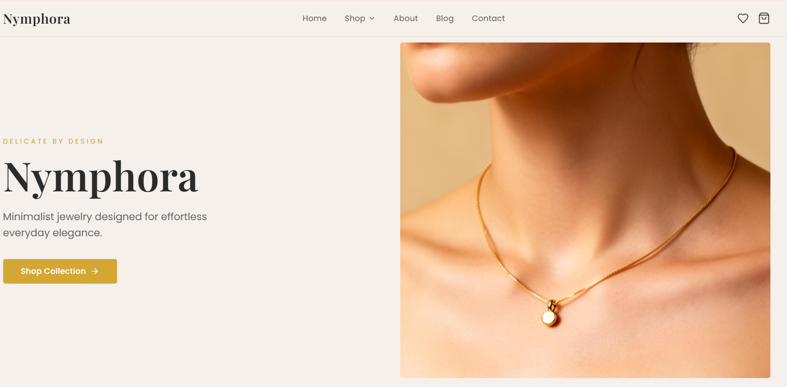
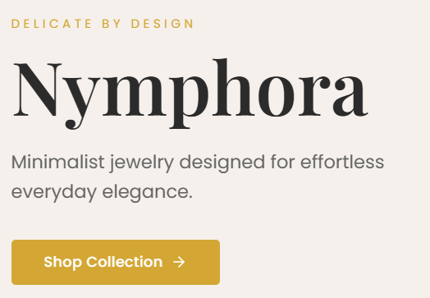
Our Website

Slide 13
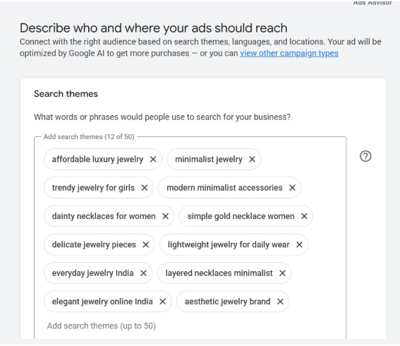
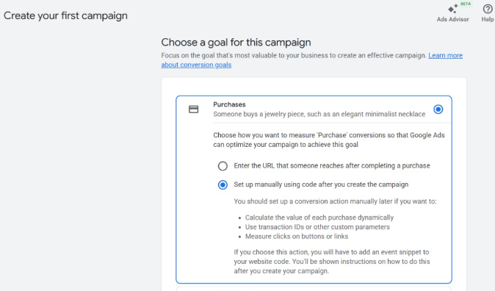
Google Ads Snapshot​

Slide 14
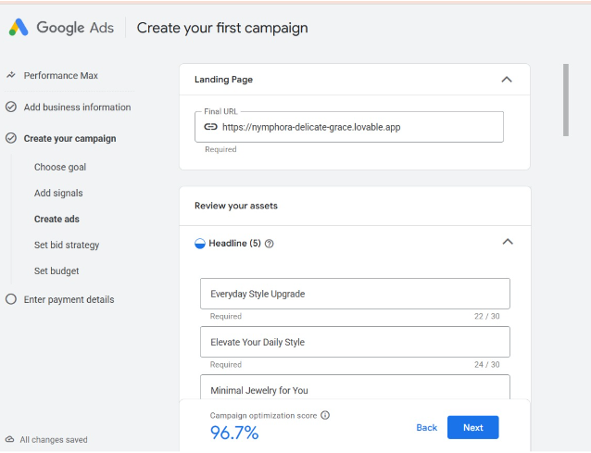
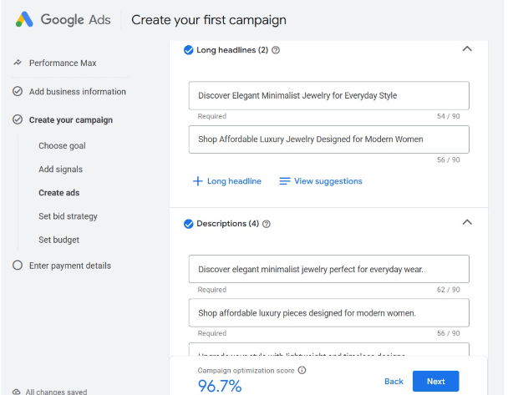
Google Ads Snapshot​

Slide 15
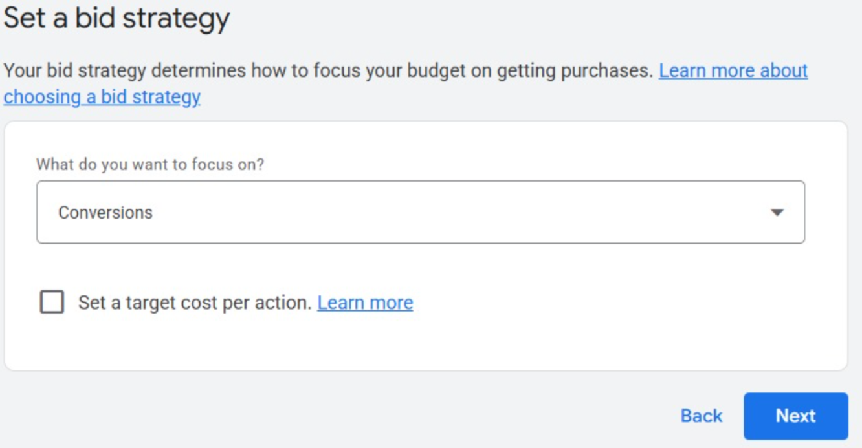
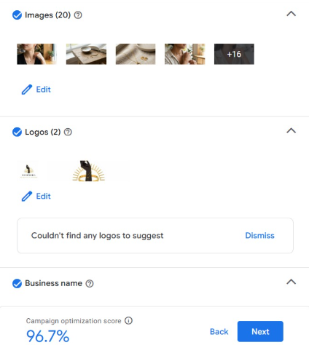
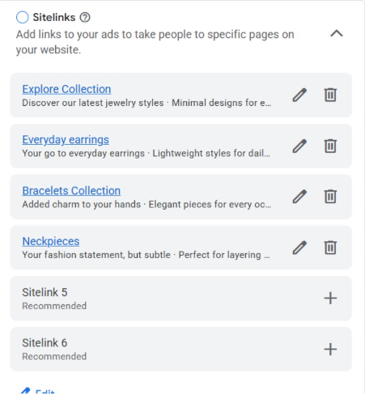
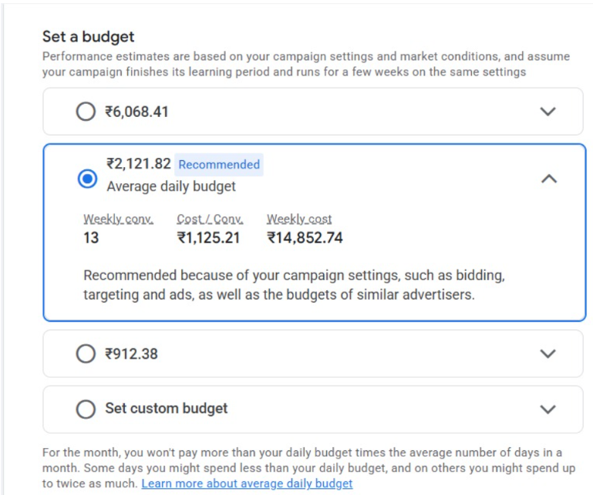
Google Ads Snapshot​

Slide 16
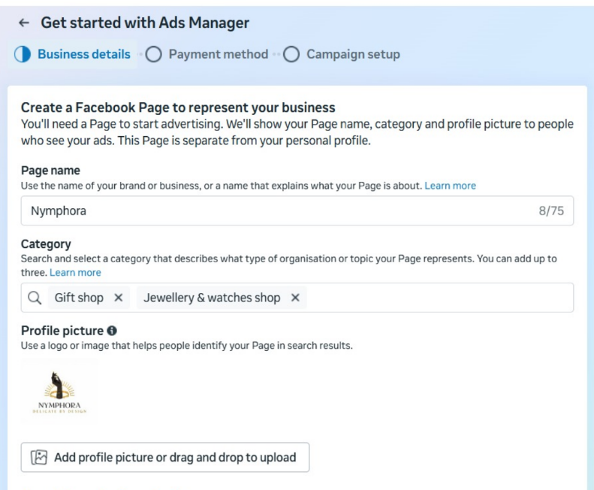
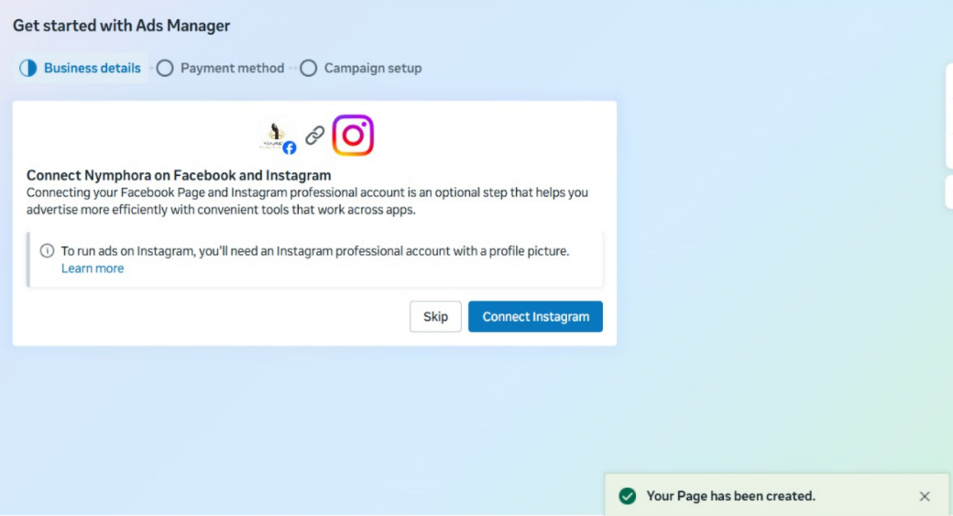
Meta Ads Snapshot

Slide 17
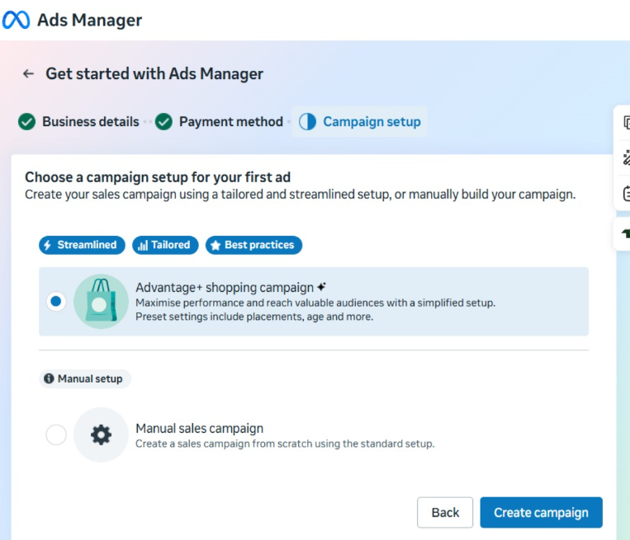
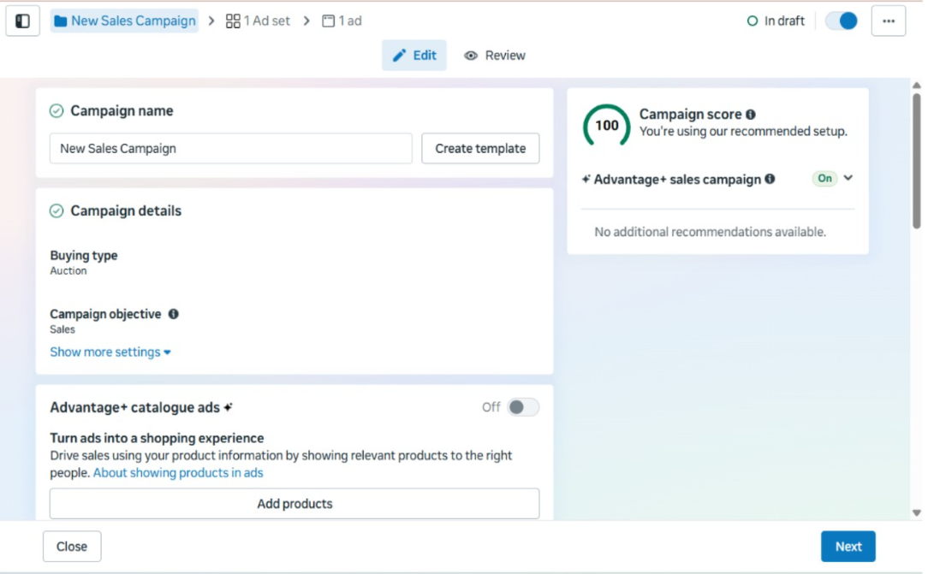
Meta Ads Snapshot

Slide 18
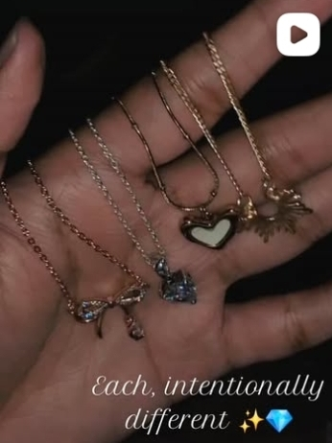
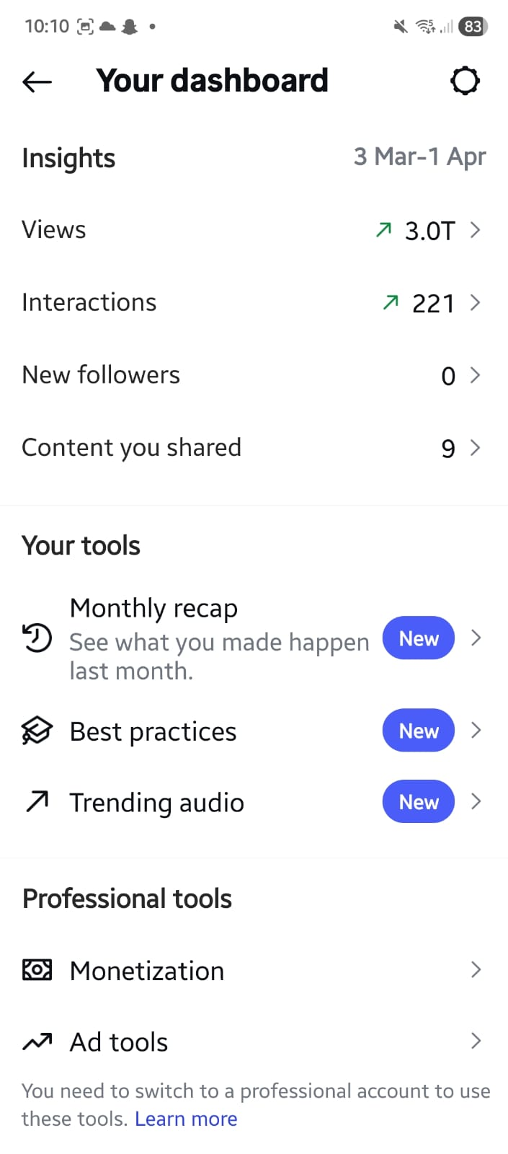
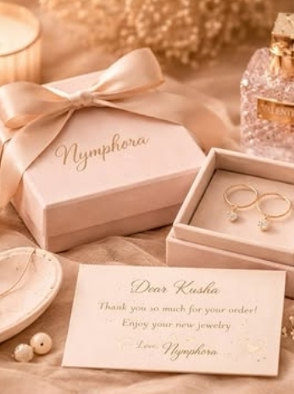
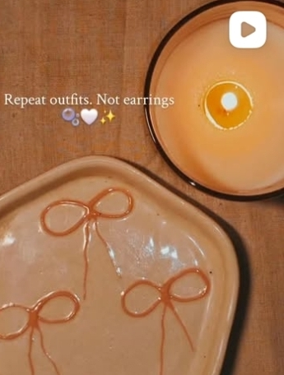
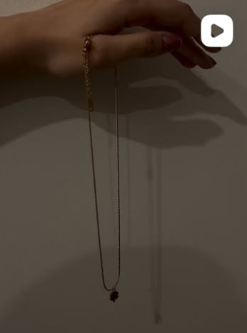
Instagram Dashboard Snapshot

Slide 19
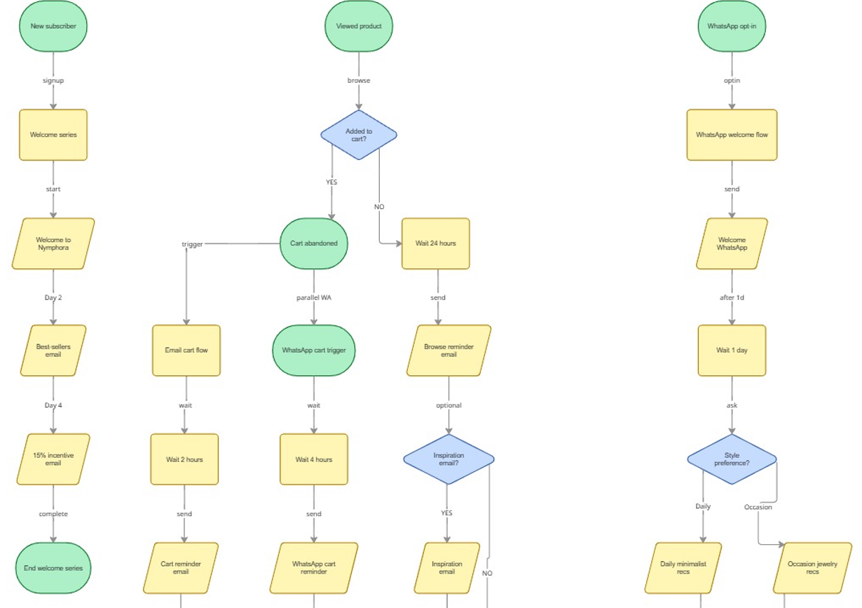
Workflow 1 (Made by MIRO)

Slide 20
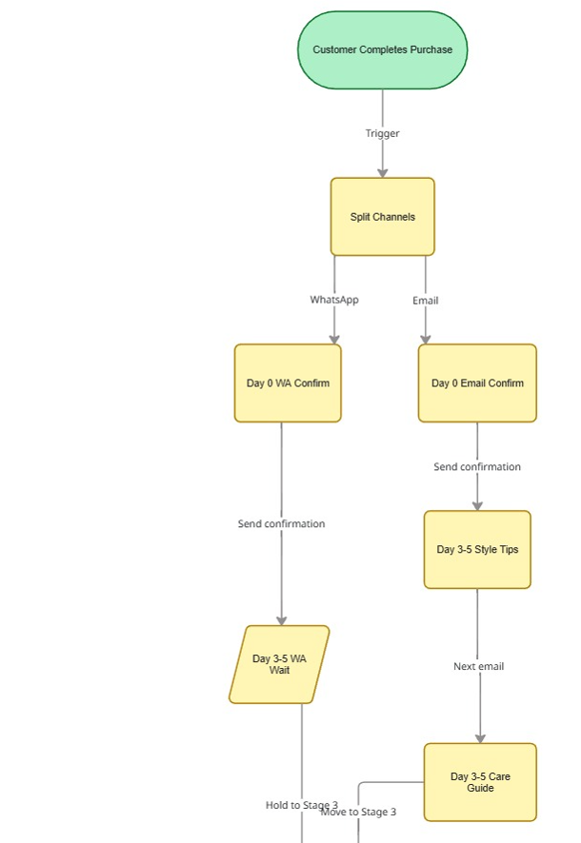
Workflow 2 (Made by MIRO)

Slide 21
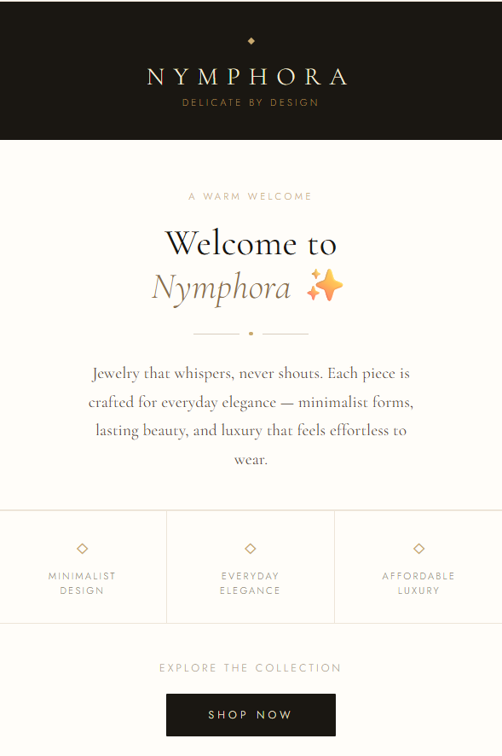
EMAIL 1: WELCOME EMAIL

Slide 22
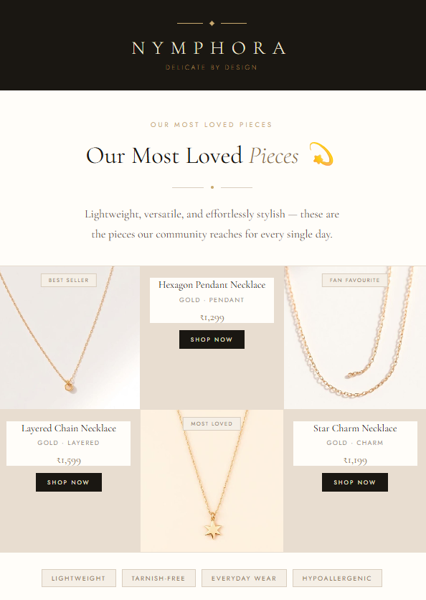
EMAIL 2: BESTSELLERS EMAIL

Slide 23
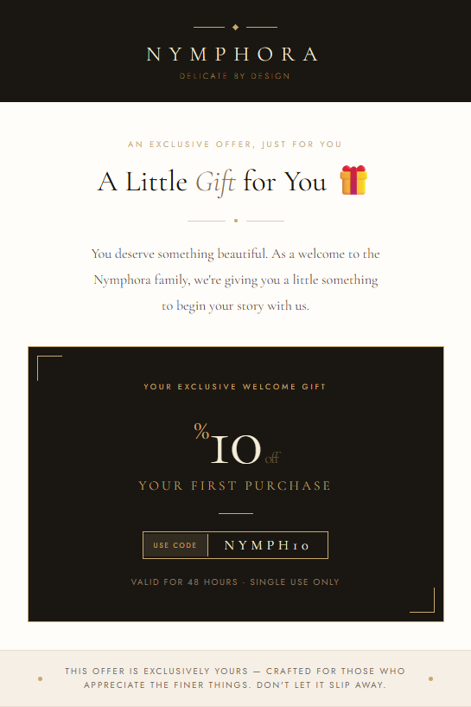
EMAIL 3: OFFER EMAIL

Slide 24
THANK YOU

